Slide 1

By-Chandana MN 20030141cse-060 Bandi Rupa sravya L20030141cse101
Rakshitha b L20030141cse104
Divyashree.A.S 200230141cse065
Data Warehousing and Data Mining
ASSIGNED BY- DR. Shashvat Sharma

Slide 2
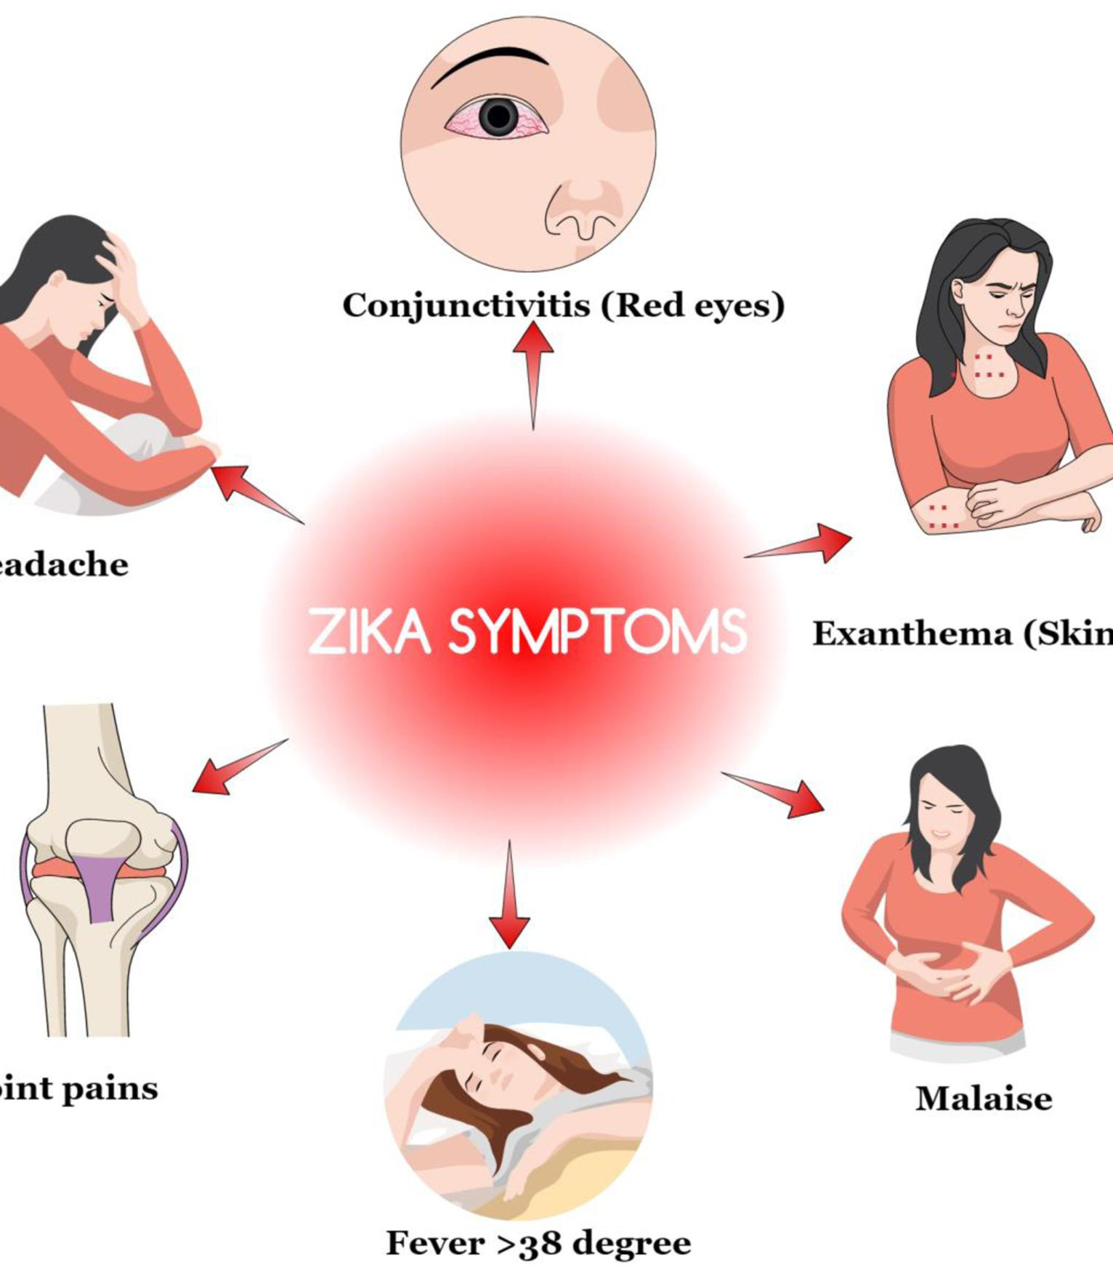
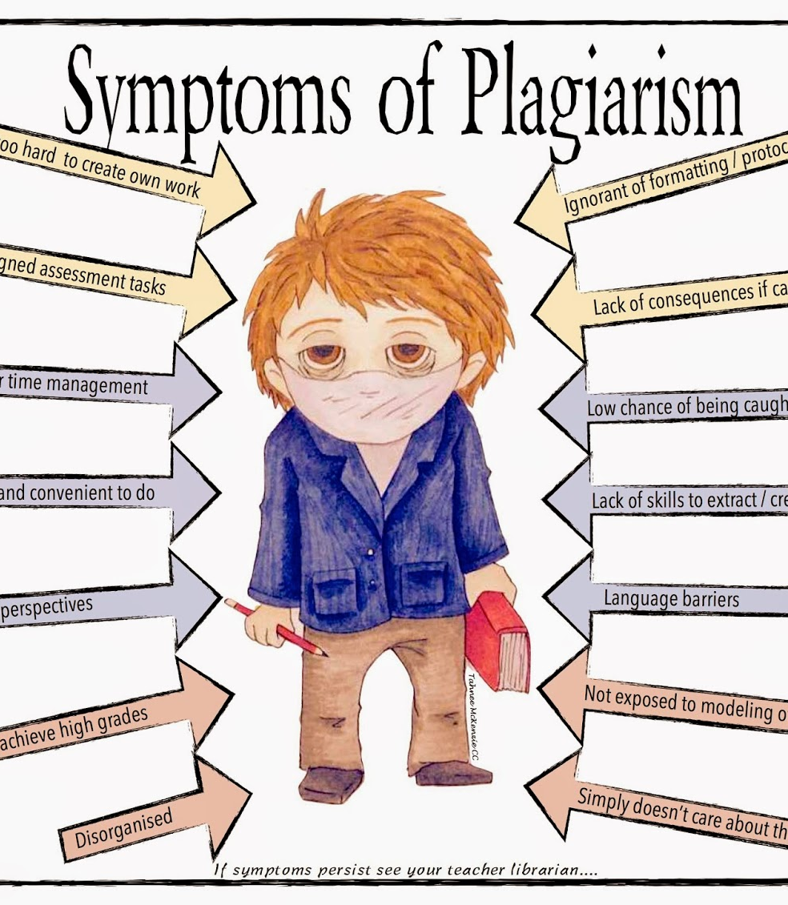
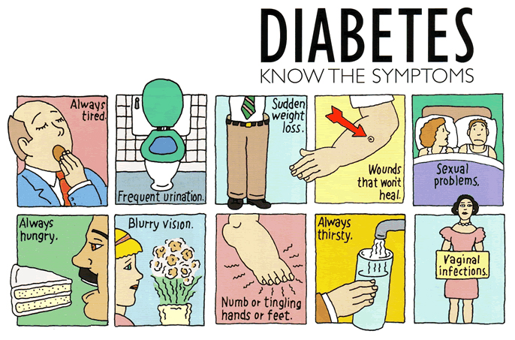
SYMPTOMS BASED DISEASE PREDICTION

Slide 3
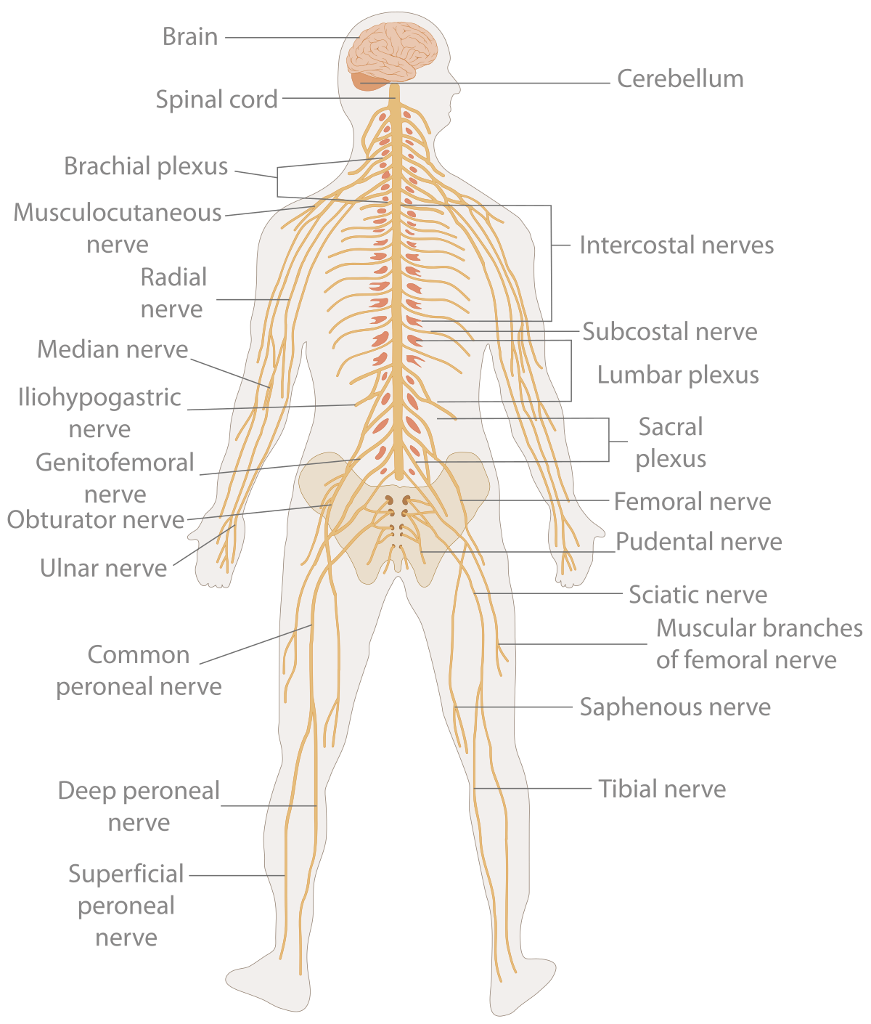


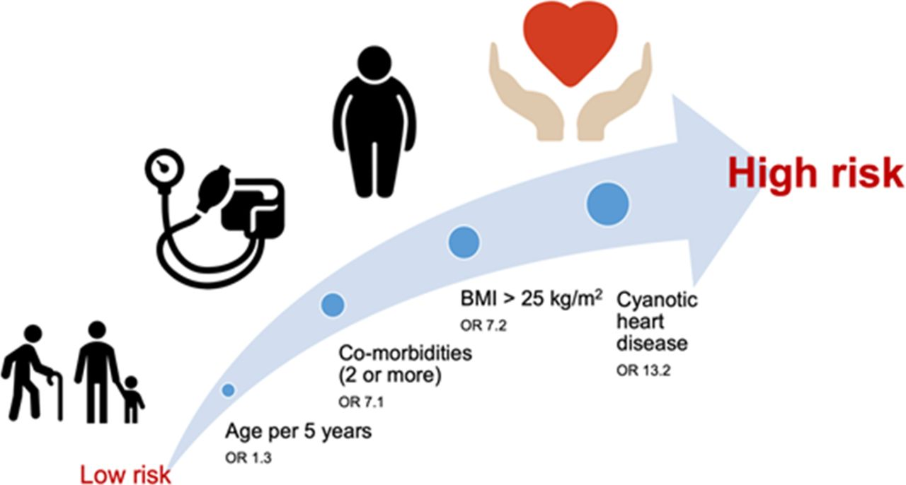
Introduction
It is a system that predicts the disease based on the information provided by the user.
This system is a helpful technique for the sake of health sector to tell the victim about the disease suffered by them.
It is also useful for the user where he or she does not like to visit to the hospital or any other clinic.
By simply entering the symptoms and related details, the victim can gain knowledge about what disease he or she is suffering from.
The health sector can also be benefited from this system by simply taking basic information from the victim.

Slide 4
Approach
Gathering the Data
Cleaning the Data
Model Building
Inference

Slide 5
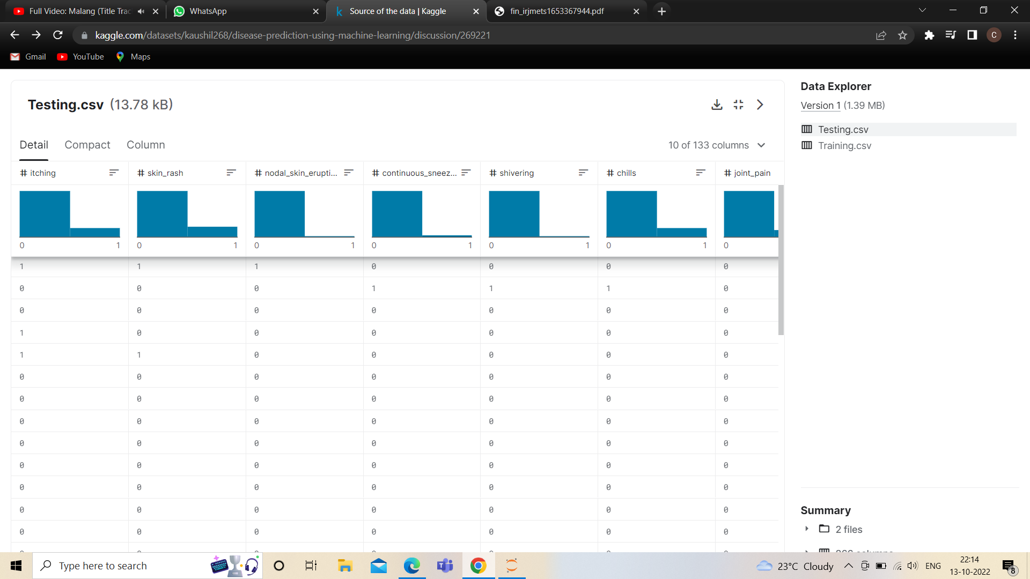
Data:

Slide 6
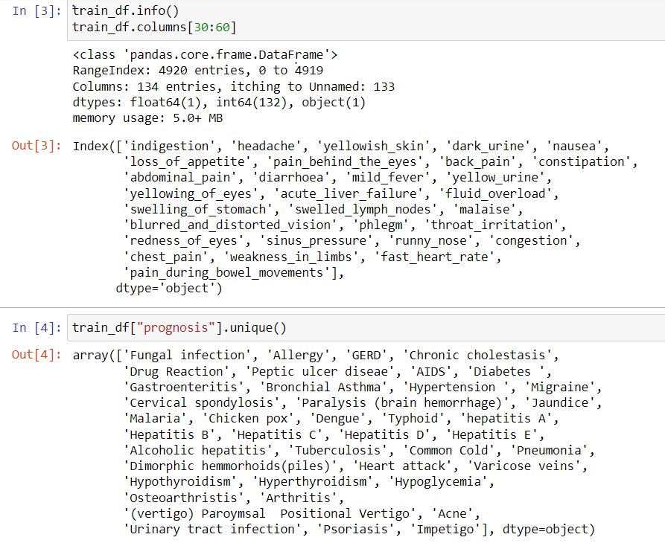
Data set description:

Slide 7
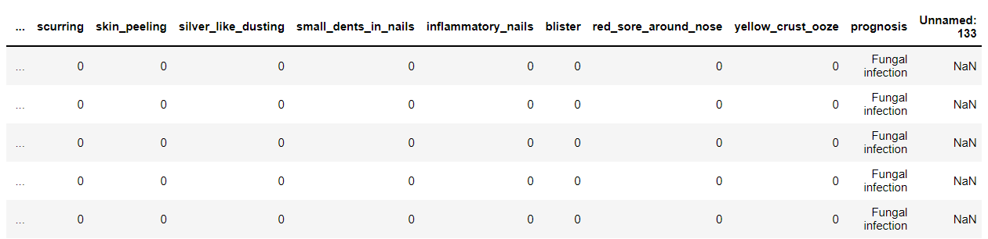
Cleaning the data:

Slide 8
Models planned to be built:
KNN
Decision Tree Classifier
Random Forest Classifier
Support Vector Classifier
Logistic Regression

Slide 9
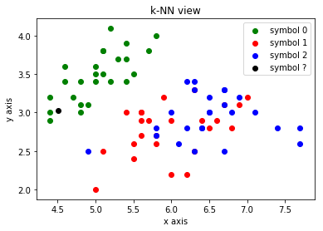
K-NN
K-NN algorithm assumes the similarity between the new case/data and available cases and put the new case into the category that is most like the available categories.
It stores all the available data and classifies a new data point based on the similarity.
This means when new data appears then it can be easily classified into a well suite category by using K- NN algorithm.
It can be used for Regression as well as for Classification but mostly it is used for the Classification problems.

Slide 10

Decision Tree Classifier
Decision Tree is a Supervised learning technique that can be used for both classification and Regression problems, but mostly it is preferred for solving Classification problems. It is a tree-structured classifier, where internal nodes represent the features of a dataset, branches represent the decision rules, and each leaf node represents the outcome.
In a Decision tree, there are two nodes, which are the Decision Node and Leaf Node. Decision nodes are used to make any decision and have multiple branches, whereas Leaf nodes are the output of those decisions and do not contain any further branches.
It is a graphical representation for getting all the possible solutions to a problem/decision based on given conditions.

Slide 11
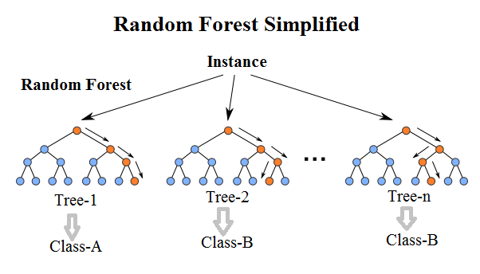
Random Forest Classifier:
Random Forest is an ensemble learning-based supervised machine learning classification algorithm that internally uses multiple decision trees to make the classification.
In a random forest classifier, all the internal decision trees are weak learners, the outputs of these weak decision trees are combined i.e. mode of all the predictions is as the final prediction.

Slide 12

Support Vector Classifier:
Support Vector Classifier is a discriminative classifier i.e. when given a labeled training data, the algorithm tries to find an optimal hyperplane that accurately separates the samples into different categories in hyperspace.
The goal of the SVM algorithm is to create the best line or decision boundary that can segregate n-dimensional space into classes so that we can easily put the new data point in the correct category in the future. This best decision boundary is called a hyperplane.
SVM chooses the extreme points/vectors that help in creating the hyperplane. These extreme cases are called as support vectors, and hence algorithm is termed as Support Vector Machine.

Slide 13
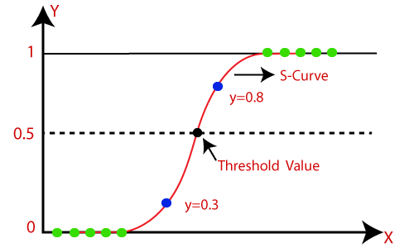
Logistic Regression
It is used for predicting the categorical dependent variable using a given set of independent variables.
Logistic regression predicts the output of a categorical dependent variable. Therefore, the outcome must be a categorical or discrete value. It can be either Yes or No, 0 or 1, true or False, etc. but instead of giving the exact value as 0 and 1, it gives the probabilistic values which lie between 0 and 1.
Logistic Regression is much like the Linear Regression except that how they are used. Linear Regression is used for solving Regression problems, whereas Logistic regression is used for solving the classification problems.

Slide 14
Inference
To build a robust model we are combining models i.e. take the mode of the predictions of all five models so that even one of the models makes wrong predictions and the other four make correct predictions then the final output would be the correct one.
This approach will help us to keep the predictions much more accurate on completely unseen data.

Slide 15

Thank you.........

